Slide 1
AI for Medicine
Lecture 19:
Deep Learning – Part I
April 05, 2021
Mohammad Hammoud
Carnegie Mellon University in Qatar

Slide 2
Today…
Last Monday’s Session:
  Logistic Regression – Part II
Today’s Session:
  Deep Learning – Part I
Announcements:
  Assignment 3 will be out by tonight. It is due on Wednesday April 14 by midnight
  Quiz II is on April 19

Slide 3
Outline
Deep Learning
Overview
Vectorization
Computation Graph
Gradient Descent

Slide 4









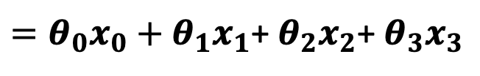



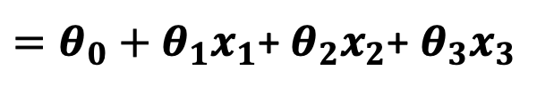
Linear Regression
What is the hypothesis function of linear regression?
  $h_{θ}=θ^{T}x$, where $θ=[θ_{0}, θ_{1}$, …, $θ_{m}$], $x=[x_{0},$ $x_{1}, …,x_{m}]$, and $x_{0}=1$
To account for the intercept term
$$x_{0}=1$$
$$θ_{0}$$
$${h_{θ}=θ}^{T}x=\left[\begin{aligned}θ_{0} \\ θ_{1} \\ θ_{2} \\ θ_{3}\end{aligned}\right]\left[x_{0} x_{1} x_{2}{ x}_{3}\right]$$
$$x_{1}$$
$$θ_{1}$$
$$x_{2}$$
$$θ_{2}$$
$$θ^{T}x$$
$$h_{θ}$$
$$θ_{3}$$
$=θ_{0}x_{0}+θ_{1}x_{1}$+ $θ_{2}x_{2}$+ $θ_{3}x_{3}$
$$x_{3}$$
$=θ_{0}+θ_{1}x_{1}$+ $θ_{2}x_{2}$+ $θ_{3}x_{3}$

Slide 5





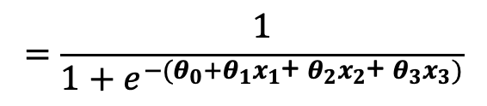








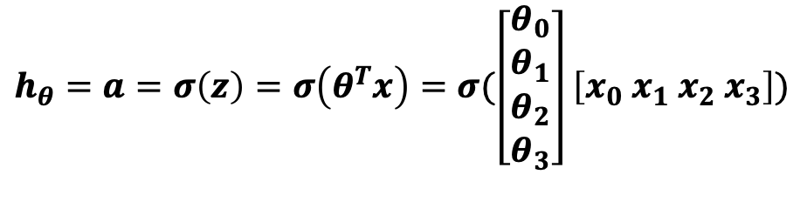
Logistic Regression
What is the hypothesis function of logistic regression?
  $h_{θ}=σ(θ^{T}x$), where $θ=[θ_{0}, θ_{1}$, …, $θ_{m}$], $x=[x_{0},$ $x_{1}, …,x_{m}]$, $x_{0}=1$, and $σ\left(z\right)=\frac{1}{1+e^{−z}}$
$$h_{θ}=a=σ\left(z\right)=σ\left(θ^{T}x\right)=σ(\left[\begin{aligned}θ_{0} \\ θ_{1} \\ θ_{2} \\ θ_{3}\end{aligned}\right]\left[x_{0} x_{1} x_{2}{ x}_{3}\right])$$
$$x_{0}=1$$
$$θ_{0}$$
To account for the intercept term
$$x_{1}$$
$$θ_{1}$$
$={σ(θ}_{0}x_{0}+θ_{1}x_{1}$+ $θ_{2}x_{2}$+ $θ_{3}x_{3})$
$$x_{2}$$
$$θ_{2}$$
$$z=θ^{T}x$$
$$a=σ(z)$$
$$h_{θ}$$
$$θ_{3}$$
$={σ(θ}_{0}+θ_{1}x_{1}$+ $θ_{2}x_{2}$+ $θ_{3}x_{3})$
$$x_{3}$$
$$=\frac{1}{1+e^{−{(θ}_{0}+θ_{1}x_{1}\text{+} θ_{2}x_{2}\text{+} θ_{3}x_{3})}}$$

Slide 6


















Towards Neural Networks
Technically, logistic regression is a neural network with only 1 neuron
$$x_{0}$$
$$x_{0}$$
$$θ_{0}$$
$$θ_{0}$$
$$x_{1}$$
$$x_{1}$$
$$θ_{1}$$
$$θ_{1}$$
$$x_{2}$$
$$θ_{2}$$
$$x_{2}$$
$$θ_{2}$$
$$h_{θ}$$
$$z=θ^{T}x$$
$$a=σ(z)$$
$$h_{θ}$$
$$z$$
$$a$$
$$θ_{3}$$
$$θ_{3}$$
Nueron
Nueron
$$x_{3}$$
$$x_{3}$$

Slide 7





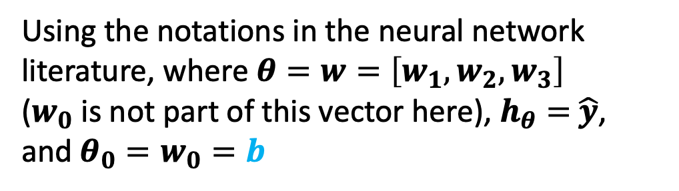

Towards Neural Networks
Technically, logistic regression is a neural network with only 1 neuron
$$x_{0}$$
$$1$$
Denoted as bias
$$θ_{0}$$
$$b$$
$$x_{1}$$
$$x_{1}$$
$$θ_{1}$$
$$w_{1}$$
$$x_{2}$$
$$θ_{2}$$
$$x_{2}$$
$$w_{2}$$
$$\hat{y}$$
$$z=θ^{T}x$$
$$a=σ(z)$$
$$h_{θ}$$
$$z$$
$$a$$
$$θ_{3}$$
$$w_{3}$$
Nueron
Nueron
$$x_{3}$$
$$x_{3}$$
Using the notations in the neural network literature, where $θ=w=\left[w_{1},w_{2},w_{3}\right]$
($w_{0}$ is not part of this vector here), $h_{θ}=$ $\hat{y}$,
and $θ_{0}=w_{0}=b$

Slide 8



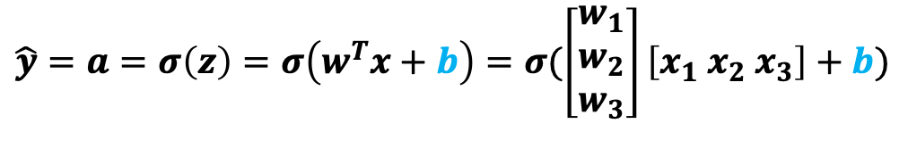






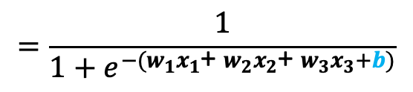
Towards Neural Networks
Technically, logistic regression is a neural network with only 1 neuron
$$1$$
$$\hat{y}=a=σ\left(z\right)=σ\left(w^{T}x+b\right)=σ(\left[\begin{aligned}w_{1} \\ w_{2} \\ w_{3}\end{aligned}\right]\left[x_{1} x_{2}{ x}_{3}\right]+b)$$
$$b$$
$$z=w^{T}x+b$$
$$x_{1}$$
$$w_{1}$$
$$w_{2}$$
$$\hat{y}$$
$=σ(w_{1}x_{1}$+ $w_{2}x_{2}$+ $w_{3}x_{3}+b)$
$$x_{2}$$
$$z$$
$$a$$
$$w_{3}$$
$$=\frac{1}{1+e^{−(w_{1}x_{1}\text{+} w_{2}x_{2}\text{+} w_{3}x_{3}+b)}}$$
$$x_{3}$$
$$a=σ(z)$$

Slide 9












Neural Networks
We can construct a network of neurons (i.e., a neural network) with as many layers, and neurons in any layer, as needed
$$z_{1}^{[1]}$$
$$a_{1}^{[1]}$$
$$x_{0}$$
$$x_{1}$$
$$z_{2}^{[1]}$$
$$a_{2}^{[1]}$$
$$x_{2}$$
$$z_{3}^{[1]}$$
$$a_{3}^{[1]}$$
$$x_{3}$$
$$z_{4}^{[1]}$$
$$a_{4}^{[1]}$$
Input Layer
(or Layer 0)
Layer 1

Slide 10
Neural Networks
We can construct a network of neurons (i.e., a neural network) with as many layers, and neurons in any layer, as needed
To indicate that this activation, a, is in layer 1
$$z_{1}^{[1]}$$
$$a_{1}^{[1]}$$
$$x_{0}$$
$$x_{1}$$
$$z_{2}^{[1]}$$
$$a_{2}^{[1]}$$
$$x_{2}$$
$$z_{3}^{[1]}$$
$$a_{3}^{[1]}$$
$$x_{3}$$
$$z_{4}^{[1]}$$
$$a_{4}^{[1]}$$
Input Layer
(or Layer 0)
Layer 1

Slide 11
Neural Networks
We can construct a network of neurons (i.e., a neural network) with as many layers, and neurons in any layer, as needed
$$z_{1}^{[1]}$$
$$a_{1}^{[1]}$$
$$x_{0}$$
$$x_{1}$$
$$z_{2}^{[1]}$$
$$a_{2}^{[1]}$$
$$x_{2}$$
$$z_{3}^{[1]}$$
$$a_{3}^{[1]}$$
$$x_{3}$$
$$z_{4}^{[1]}$$
$$a_{4}^{[1]}$$
Input Layer
(or Layer 0)
Layer 1

Slide 12
Neural Networks
We can construct a network of neurons (i.e., a neural network) with as many layers, and neurons in any layer, as needed
$$z_{1}^{[1]}$$
$$a_{1}^{[1]}$$
$$x_{0}$$
$$x_{1}$$
$$z_{2}^{[1]}$$
$$a_{2}^{[1]}$$
$$x_{2}$$
$$z_{3}^{[1]}$$
$$a_{3}^{[1]}$$
$$x_{3}$$
$$z_{4}^{[1]}$$
$$a_{4}^{[1]}$$
Input Layer
(or Layer 0)
Layer 1

Slide 13
Neural Networks
We can construct a network of neurons (i.e., a neural network) with as many layers, and neurons in any layer, as needed
$$z_{1}^{[1]}$$
$$a_{1}^{[1]}$$
$$x_{0}$$
$$x_{1}$$
$$z_{2}^{[1]}$$
$$a_{2}^{[1]}$$
$$x_{2}$$
$$z_{3}^{[1]}$$
$$a_{3}^{[1]}$$
$$x_{3}$$
$$z_{4}^{[1]}$$
$$a_{4}^{[1]}$$
Input Layer
(or Layer 0)
Layer 1

Slide 14
Neural Networks
We can construct a network of neurons (i.e., a neural network) with as many layers, and neurons in any layer, as needed
$$z_{1}^{[1]}$$
$$a_{1}^{[1]}$$
$$x_{0}$$
$$x_{1}$$
$$z_{2}^{[1]}$$
$$a_{2}^{[1]}$$
$$x_{2}$$
$$z_{3}^{[1]}$$
$$a_{3}^{[1]}$$
$$x_{3}$$
$$z_{4}^{[1]}$$
$$a_{4}^{[1]}$$
Input Layer
(or Layer 0)
Layer 1

Slide 15


Neural Networks
We can construct a network of neurons (i.e., a neural network) with as many layers, and neurons in any layer, as needed
$$z_{1}^{[1]}$$
$$a_{1}^{[1]}$$
$$x_{0}$$
$$x_{1}$$
$$z_{2}^{[1]}$$
$$a_{2}^{[1]}$$
$$x_{2}$$
$$z_{1}^{[2]}$$
$$a_{1}^{[2]}$$
$$z_{3}^{[1]}$$
$$a_{3}^{[1]}$$
$$x_{3}$$
Layer 2
$$z_{4}^{[1]}$$
$$a_{4}^{[1]}$$
Input Layer
(or Layer 0)
Layer 1

Slide 16

Neural Networks
We can construct a network of neurons (i.e., a neural network) with as many layers, and neurons in any layer, as needed
$$z_{1}^{[1]}$$
$$a_{1}^{[1]}$$
$$x_{0}$$
By convention, this neural network is said to have 2 layers (and not 3) since the input layer is typically not counted!
$$x_{1}$$
$$z_{2}^{[1]}$$
$$a_{2}^{[1]}$$
$$x_{2}$$
$$z_{1}^{[2]}$$
$$a_{1}^{[2]}$$
$$\hat{y}$$
$$z_{3}^{[1]}$$
$$a_{3}^{[1]}$$
$$x_{3}$$
Layer 2
Output layer
$$z_{4}^{[1]}$$
$$a_{4}^{[1]}$$
Input Layer
(or Layer 0)
Hidden layer with 4 neurons
Layer 1

Slide 17
Neural Networks
We can construct a network of neurons (i.e., a neural network) with as many layers, and neurons in any layer, as needed
$$z_{1}^{[1]}$$
$$a_{1}^{[1]}$$
$$x_{0}$$
Also, the more layers we add, the deeper the neural network becomes, giving rise to the concept of
deep learning!
$$x_{1}$$
$$z_{2}^{[1]}$$
$$a_{2}^{[1]}$$
$$x_{2}$$
$$z_{1}^{[2]}$$
$$a_{1}^{[2]}$$
$$\hat{y}$$
$$z_{3}^{[1]}$$
$$a_{3}^{[1]}$$
$$x_{3}$$
Layer 2
Output layer
$$z_{4}^{[1]}$$
$$a_{4}^{[1]}$$
Input Layer
(or Layer 0)
Hidden layer with 4 neurons
Layer 1

Slide 18
Neural Networks
We can construct a network of neurons (i.e., a neural network) with as many layers, and neurons in any layer, as needed
$$z_{1}^{[1]}$$
$$a_{1}^{[1]}$$
$$x_{0}$$
Interestingly, neural networks learn their own features!
$$x_{1}$$
$$z_{2}^{[1]}$$
$$a_{2}^{[1]}$$
$$x_{2}$$
$$z_{1}^{[2]}$$
$$a_{1}^{[2]}$$
$$\hat{y}$$
$$z_{3}^{[1]}$$
$$a_{3}^{[1]}$$
$$x_{3}$$
Layer 2
Output layer
$$z_{4}^{[1]}$$
$$a_{4}^{[1]}$$
Input Layer
(or Layer 0)
Hidden layer with 4 neurons
Layer 1

Slide 19

Neural Networks
We can construct a network of neurons (i.e., a neural network) with as many layers, and neurons in any layer, as needed
$$z_{1}^{[1]}$$
$$a_{1}^{[1]}$$
This looks like logistic regression, but with features that were learnt (i.e., $a_{1}^{[1]}$, $a_{2}^{[1]}$, $a_{3}^{[1]}$, $a_{4}^{[1]}$) and NOT engineered by us (i.e., $x_{1}$, $x_{2}$, and $x_{3}$)
$$z_{2}^{[1]}$$
$$a_{2}^{[1]}$$
$$z_{1}^{[2]}$$
$$a_{1}^{[2]}$$
$$\hat{y}$$
$$z_{3}^{[1]}$$
$$a_{3}^{[1]}$$
Layer 2
Output layer
$$z_{4}^{[1]}$$
$$a_{4}^{[1]}$$
Hidden layer with 4 neurons
Layer 1

Slide 20
Outline
Deep Learning
Overview
Vectorization
Computation Graph
Gradient Descent

Slide 21
Vectorizing Input and All Variables
To help develop an efficient learning algorithm, let us vectorize (represent in vectors & matrices) the input and the variables involved
$$z_{1}^{[1]}$$
$$a_{1}^{[1]}$$
$$x_{0}$$
$$x_{1}$$
$$z_{2}^{[1]}$$
$$a_{2}^{[1]}$$
$$x_{2}$$
$$z_{1}^{[2]}$$
$$a_{1}^{[2]}$$
$$\hat{y}$$
$$z_{3}^{[1]}$$
$$a_{3}^{[1]}$$
$$x_{3}$$
Layer 2
$$z_{4}^{[1]}$$
$$a_{4}^{[1]}$$
Input Layer
(or Layer 0)
Layer 1

Slide 22

Vectorizing Input and All Variables
To help develop an efficient learning algorithm, let us vectorize (represent in vectors & matrices) the input and the variables involved
$$z_{1}^{[1]}$$
$$a_{1}^{[1]}$$
$$x=\left[\begin{aligned}x_{1} \\ x_{2} \\ x_{3}\end{aligned}\right]$$
$$x_{0}$$
$$x_{1}$$
$$z_{2}^{[1]}$$
$$a_{2}^{[1]}$$
$$x_{2}$$
$$z_{1}^{[2]}$$
$$a_{1}^{[2]}$$
$$\hat{y}$$
$$z_{3}^{[1]}$$
$$a_{3}^{[1]}$$
$$x_{3}$$
Layer 2
$$z_{4}^{[1]}$$
$$a_{4}^{[1]}$$
Input Layer
(or Layer 0)
Layer 1

Slide 23

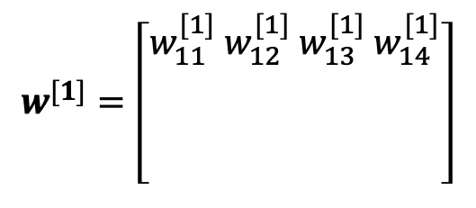



Vectorizing Input and All Variables
To help develop an efficient learning algorithm, let us vectorize (represent in vectors & matrices) the input and the variables involved
$$z_{1}^{[1]}$$
$$a_{1}^{[1]}$$
$$w^{[1]}=\left[\begin{aligned}w_{11}^{[1]}{ w}_{12}^{[1]}{ w}_{13}^{[1]}{ w}_{14}^{[1]} \\ w_{21}^{[1]}{ w}_{22}^{[1]}{ w}_{23}^{[1]}{ w}_{24}^{[1]} \\ w_{31}^{[1]}{ w}_{32}^{[1]}{ w}_{33}^{[1]}{ w}_{34}^{[1]}\end{aligned}\right]$$
$$w_{11}^{[1]}$$
$$x_{0}$$
$$w_{12}^{[1]}$$
$$x_{1}$$
$$z_{2}^{[1]}$$
$$a_{2}^{[1]}$$
$$w_{13}^{[1]}$$
$$x_{2}$$
$$z_{1}^{[2]}$$
$$a_{1}^{[2]}$$
$$\hat{y}$$
$$w_{14}^{[1]}$$
$$z_{3}^{[1]}$$
$$a_{3}^{[1]}$$
$$x_{3}$$
Layer 2
$$z_{4}^{[1]}$$
$$a_{4}^{[1]}$$
Input Layer
(or Layer 0)
Layer 1

Slide 24
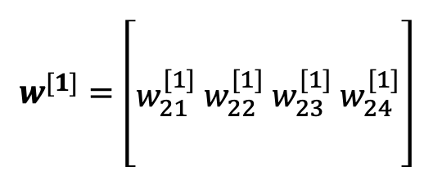
Vectorizing Input and All Variables
To help develop an efficient learning algorithm, let us vectorize (represent in vectors & matrices) the input and the variables involved
$$z_{1}^{[1]}$$
$$a_{1}^{[1]}$$
$$w^{[1]}=\left[\begin{aligned}w_{11}^{[1]}{ w}_{12}^{[1]}{ w}_{13}^{[1]}{ w}_{14}^{[1]} \\ w_{21}^{[1]}{ w}_{22}^{[1]}{ w}_{23}^{[1]}{ w}_{24}^{[1]} \\ w_{31}^{[1]}{ w}_{32}^{[1]}{ w}_{33}^{[1]}{ w}_{34}^{[1]}\end{aligned}\right]$$
$$x_{0}$$
$$x_{1}$$
$$z_{2}^{[1]}$$
$$a_{2}^{[1]}$$
$$x_{2}$$
$$z_{1}^{[2]}$$
$$a_{1}^{[2]}$$
$$\hat{y}$$
$$z_{3}^{[1]}$$
$$a_{3}^{[1]}$$
$$x_{3}$$
Layer 2
$$z_{4}^{[1]}$$
$$a_{4}^{[1]}$$
Input Layer
(or Layer 0)
Layer 1

Slide 25
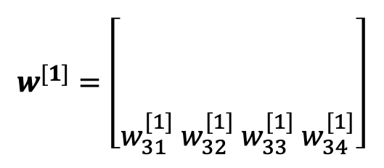
Vectorizing Input and All Variables
To help develop an efficient learning algorithm, let us vectorize (represent in vectors & matrices) the input and the variables involved
$$z_{1}^{[1]}$$
$$a_{1}^{[1]}$$
$$w^{[1]}=\left[\begin{aligned}w_{11}^{[1]}{ w}_{12}^{[1]}{ w}_{13}^{[1]}{ w}_{14}^{[1]} \\ w_{21}^{[1]}{ w}_{22}^{[1]}{ w}_{23}^{[1]}{ w}_{24}^{[1]} \\ w_{31}^{[1]}{ w}_{32}^{[1]}{ w}_{33}^{[1]}{ w}_{34}^{[1]}\end{aligned}\right]$$
$$x_{0}$$
$$x_{1}$$
$$z_{2}^{[1]}$$
$$a_{2}^{[1]}$$
$$x_{2}$$
$$z_{1}^{[2]}$$
$$a_{1}^{[2]}$$
$$\hat{y}$$
$$z_{3}^{[1]}$$
$$a_{3}^{[1]}$$
$$x_{3}$$
Layer 2
$$z_{4}^{[1]}$$
$$a_{4}^{[1]}$$
Input Layer
(or Layer 0)
Layer 1

Slide 26

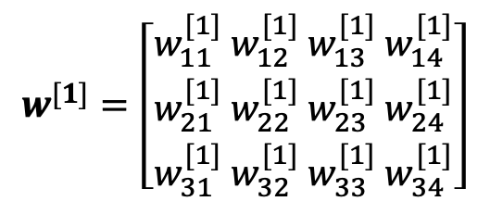
Vectorizing Input and All Variables
To help develop an efficient learning algorithm, let us vectorize (represent in vectors & matrices) the input and the variables involved
$$z_{1}^{[1]}$$
$$a_{1}^{[1]}$$
$$w^{[1]}=\left[\begin{aligned}w_{11}^{[1]}{ w}_{12}^{[1]}{ w}_{13}^{[1]}{ w}_{14}^{[1]} \\ w_{21}^{[1]}{ w}_{22}^{[1]}{ w}_{23}^{[1]}{ w}_{24}^{[1]} \\ w_{31}^{[1]}{ w}_{32}^{[1]}{ w}_{33}^{[1]}{ w}_{34}^{[1]}\end{aligned}\right]$$
$$x_{0}$$
$$x_{1}$$
$$z_{2}^{[1]}$$
$$a_{2}^{[1]}$$
$$x_{2}$$
$$z_{1}^{[2]}$$
$$a_{1}^{[2]}$$
$$\hat{y}$$
Dimension of $w^{[1]}$= (3, 4)
$$z_{3}^{[1]}$$
$$a_{3}^{[1]}$$
$$x_{3}$$
Layer 2
$$z_{4}^{[1]}$$
$$a_{4}^{[1]}$$
Input Layer
(or Layer 0)
Layer 1

Slide 27


Vectorizing Input and All Variables
To help develop an efficient learning algorithm, let us vectorize (represent in vectors & matrices) the input and the variables involved
$$w^{{[1]}^{T}}=\left[\begin{aligned}w_{11}^{[1]}{ w}_{21}^{[1]}{ w}_{31}^{[1]} \\ w_{12}^{[1]}{ w}_{22}^{[1]}{ w}_{32}^{[1]} \\ w_{13}^{[1]}{ w}_{23}^{[1]}{ w}_{33}^{[1]} \\ w_{14}^{[1]}{ w}_{24}^{[1]}{ w}_{34}^{[1]}\end{aligned}\right]$$
$$z_{1}^{[1]}$$
$$a_{1}^{[1]}$$
$$x_{0}$$
$$x_{1}$$
$$z_{2}^{[1]}$$
$$a_{2}^{[1]}$$
$$x_{2}$$
$$z_{1}^{[2]}$$
$$a_{1}^{[2]}$$
$$\hat{y}$$
$$z_{3}^{[1]}$$
$$a_{3}^{[1]}$$
Dimension of${ w}^{{[1]}^{T}}$= (4, 3)
$$x_{3}$$
Layer 2
$$z_{4}^{[1]}$$
$$a_{4}^{[1]}$$
Input Layer
(or Layer 0)
Layer 1

Slide 28





Vectorizing Input and All Variables
To help develop an efficient learning algorithm, let us vectorize (represent in vectors & matrices) the input and the variables involved
$$b_{1}^{[1]}$$
$$b^{[1]}=\left[\begin{aligned}b_{1}^{[1]} \\ b_{2}^{[1]} \\ b_{3}^{[1]} \\ b_{4}^{[1]}\end{aligned}\right]$$
$$z_{1}^{[1]}$$
$$a_{1}^{[1]}$$
$$x_{0}$$
$$b_{2}^{[1]}$$
$$x_{1}$$
$$z_{2}^{[1]}$$
$$a_{2}^{[1]}$$
$$b_{3}^{[1]}$$
$$x_{2}$$
$$z_{1}^{[2]}$$
$$a_{1}^{[2]}$$
$$\hat{y}$$
$$b_{4}^{[1]}$$
$$z_{3}^{[1]}$$
$$a_{3}^{[1]}$$
$$x_{3}$$
Layer 2
$$z_{4}^{[1]}$$
$$a_{4}^{[1]}$$
Input Layer
(or Layer 0)
Layer 1

Slide 29

Vectorizing Input and All Variables
To help develop an efficient learning algorithm, let us vectorize (represent in vectors & matrices) the input and the variables involved
$$z^{[1]}=\left[\begin{aligned}z_{1}^{[1]} \\ z_{2}^{[1]} \\ z_{3}^{[1]} \\ z_{4}^{[1]}\end{aligned}\right]$$
$$z_{1}^{[1]}$$
$$a_{1}^{[1]}$$
$$x_{0}$$
$$x_{1}$$
$$z_{2}^{[1]}$$
$$a_{2}^{[1]}$$
$$x_{2}$$
$$z_{1}^{[2]}$$
$$a_{1}^{[2]}$$
$$\hat{y}$$
$$z_{3}^{[1]}$$
$$a_{3}^{[1]}$$
$$x_{3}$$
Layer 2
$$z_{4}^{[1]}$$
$$a_{4}^{[1]}$$
Input Layer
(or Layer 0)
Layer 1

Slide 30

Vectorizing Input and All Variables
To help develop an efficient learning algorithm, let us vectorize (represent in vectors & matrices) the input and the variables involved
$$a^{[1]}=\left[\begin{aligned}a_{1}^{[1]} \\ a_{2}^{[1]} \\ a_{3}^{[1]} \\ a_{4}^{[1]}\end{aligned}\right]$$
$$z_{1}^{[1]}$$
$$a_{1}^{[1]}$$
$$x_{0}$$
$$x_{1}$$
$$z_{2}^{[1]}$$
$$a_{2}^{[1]}$$
$$x_{2}$$
$$z_{1}^{[2]}$$
$$a_{1}^{[2]}$$
$$\hat{y}$$
$$z_{3}^{[1]}$$
$$a_{3}^{[1]}$$
$$x_{3}$$
Layer 2
$$z_{4}^{[1]}$$
$$a_{4}^{[1]}$$
Input Layer
(or Layer 0)
Layer 1

Slide 31
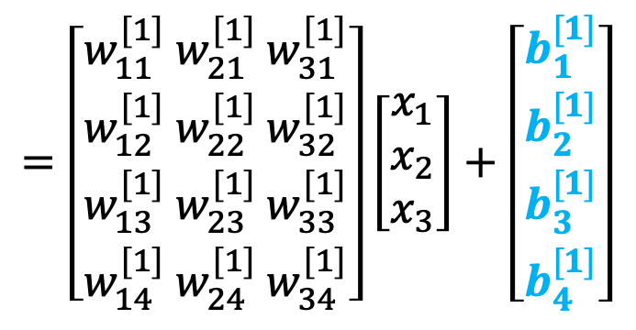

Vectorizing Input and All Variables
To help develop an efficient learning algorithm, let us vectorize (represent in vectors & matrices) the input and the variables involved
$$z_{1}^{[1]}$$
$$a_{1}^{[1]}$$
$$z^{[1]}=w^{{[1]}^{T}}x+b^{[1]}$$
$$x_{0}$$
$$=\left[\begin{aligned}w_{11}^{[1]}{ w}_{21}^{[1]}{ w}_{31}^{[1]} \\ w_{12}^{[1]}{ w}_{22}^{[1]}{ w}_{32}^{[1]} \\ w_{13}^{[1]}{ w}_{23}^{[1]}{ w}_{33}^{[1]} \\ w_{14}^{[1]}{ w}_{24}^{[1]}{ w}_{34}^{[1]}\end{aligned}\right]\left[\begin{aligned}x_{1} \\ x_{2} \\ x_{3}\end{aligned}\right]+\left[\begin{aligned}b_{1}^{[1]} \\ b_{2}^{[1]} \\ b_{3}^{[1]} \\ b_{4}^{[1]}\end{aligned}\right]$$
$$x_{1}$$
$$z_{2}^{[1]}$$
$$a_{2}^{[1]}$$
$$x_{2}$$
$$z_{1}^{[2]}$$
$$a_{1}^{[2]}$$
$$\hat{y}$$
$$z_{3}^{[1]}$$
$$a_{3}^{[1]}$$
$$x_{3}$$
Layer 2
$$z_{4}^{[1]}$$
$$a_{4}^{[1]}$$
Input Layer
(or Layer 0)
Layer 1

Slide 32
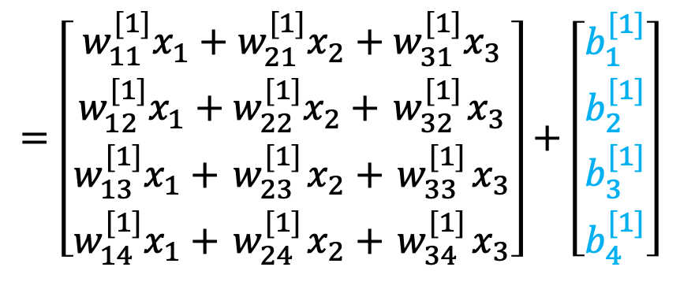
Vectorizing Input and All Variables
To help develop an efficient learning algorithm, let us vectorize (represent in vectors & matrices) the input and the variables involved
$$z_{1}^{[1]}$$
$$a_{1}^{[1]}$$
$$z^{[1]}=w^{{[1]}^{T}}x+b^{[1]}$$
$$x_{0}$$
$$=\left[\begin{aligned}w_{11}^{[1]}x_{1}+w_{21}^{[1]}x_{2}+w_{31}^{[1]}x_{3} \\ w_{12}^{[1]}{x_{1}+w}_{22}^{[1]}x_{2}+{ w}_{32}^{[1]}x_{3} \\ w_{13}^{[1]}x_{1}+{ w}_{23}^{[1]}x_{2}+{ w}_{33}^{[1]}x_{3} \\ w_{14}^{[1]}x_{1}+{ w}_{24}^{[1]}x_{2}+{ w}_{34}^{[1]}x_{3}\end{aligned}\right]+\left[\begin{aligned}b_{1}^{[1]} \\ b_{2}^{[1]} \\ b_{3}^{[1]} \\ b_{4}^{[1]}\end{aligned}\right]$$
$$x_{1}$$
$$z_{2}^{[1]}$$
$$a_{2}^{[1]}$$
$$x_{2}$$
$$z_{1}^{[2]}$$
$$a_{1}^{[2]}$$
$$\hat{y}$$
$$z_{3}^{[1]}$$
$$a_{3}^{[1]}$$
$$x_{3}$$
Layer 2
$$z_{4}^{[1]}$$
$$a_{4}^{[1]}$$
Input Layer
(or Layer 0)
Layer 1

Slide 33
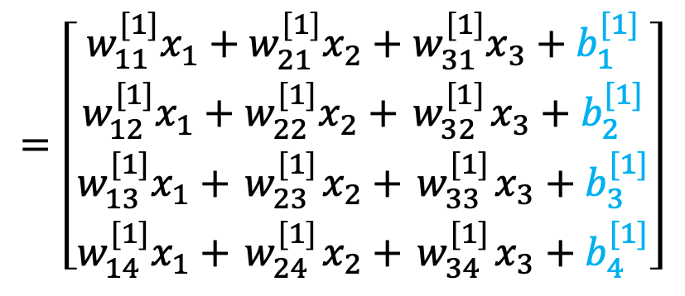
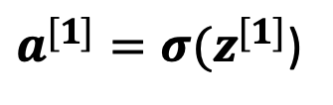
Vectorizing Input and All Variables
To help develop an efficient learning algorithm, let us vectorize (represent in vectors & matrices) the input and the variables involved
$$z_{1}^{[1]}$$
$$a_{1}^{[1]}$$
$$z^{[1]}=w^{{[1]}^{T}}x+b^{[1]}$$
$$x_{0}$$
$$=\left[\begin{aligned}w_{11}^{[1]}x_{1}+w_{21}^{[1]}x_{2}+w_{31}^{[1]}x_{3}+b_{1}^{[1]} \\ w_{12}^{[1]}{x_{1}+w}_{22}^{[1]}x_{2}+{ w}_{32}^{[1]}x_{3}+b_{2}^{[1]} \\ w_{13}^{[1]}x_{1}+{ w}_{23}^{[1]}x_{2}+{ w}_{33}^{[1]}x_{3}+b_{3}^{[1]} \\ w_{14}^{[1]}x_{1}+{ w}_{24}^{[1]}x_{2}+{ w}_{34}^{[1]}x_{3}+b_{4}^{[1]}\end{aligned}\right]$$
$$x_{1}$$
$$z_{2}^{[1]}$$
$$a_{2}^{[1]}$$
$$x_{2}$$
$$z_{1}^{[2]}$$
$$a_{1}^{[2]}$$
$$\hat{y}$$
$$z_{3}^{[1]}$$
$$a_{3}^{[1]}$$
$$x_{3}$$
Layer 2
$$z_{4}^{[1]}$$
$$a_{4}^{[1]}$$
Input Layer
(or Layer 0)
$a^{[1]}=σ(z^{[1]}$)
Layer 1

Slide 34
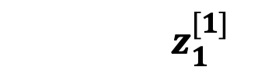
Vectorizing Input and All Variables
To help develop an efficient learning algorithm, let us vectorize (represent in vectors & matrices) the input and the variables involved
$$z_{1}^{[1]}$$
$$a_{1}^{[1]}$$
$$z^{[1]}=w^{{[1]}^{T}}x+b^{[1]}$$
$$x_{0}$$
$$=\left[\begin{aligned}w_{11}^{[1]}x_{1}+w_{21}^{[1]}x_{2}+w_{31}^{[1]}x_{3}+b_{1}^{[1]} \\ w_{12}^{[1]}{x_{1}+w}_{22}^{[1]}x_{2}+{ w}_{32}^{[1]}x_{3}+b_{2}^{[1]} \\ w_{13}^{[1]}x_{1}+{ w}_{23}^{[1]}x_{2}+{ w}_{33}^{[1]}x_{3}+b_{3}^{[1]} \\ w_{14}^{[1]}x_{1}+{ w}_{24}^{[1]}x_{2}+{ w}_{34}^{[1]}x_{3}+b_{4}^{[1]}\end{aligned}\right]$$
$$x_{1}$$
$$z_{2}^{[1]}$$
$$a_{2}^{[1]}$$
$$x_{2}$$
$$z_{1}^{[2]}$$
$$a_{1}^{[2]}$$
$$\hat{y}$$
$$z_{3}^{[1]}$$
$$a_{3}^{[1]}$$
$$x_{3}$$
Layer 2
$$z_{4}^{[1]}$$
$$a_{4}^{[1]}$$
Input Layer
(or Layer 0)
$a^{[1]}=σ(z^{[1]}$)
$${a_{1}^{[1]}=σ(z}_{1}^{[1]})$$
Layer 1

Slide 35
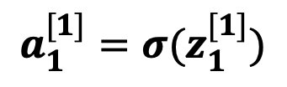
Vectorizing Input and All Variables
To help develop an efficient learning algorithm, let us vectorize (represent in vectors & matrices) the input and the variables involved
$$z_{1}^{[1]}$$
$$a_{1}^{[1]}$$
$$z^{[1]}=w^{{[1]}^{T}}x+b^{[1]}$$
$$x_{0}$$
$$=\left[\begin{aligned}w_{11}^{[1]}x_{1}+w_{21}^{[1]}x_{2}+w_{31}^{[1]}x_{3}+b_{1}^{[1]} \\ w_{12}^{[1]}{x_{1}+w}_{22}^{[1]}x_{2}+{ w}_{32}^{[1]}x_{3}+b_{2}^{[1]} \\ w_{13}^{[1]}x_{1}+{ w}_{23}^{[1]}x_{2}+{ w}_{33}^{[1]}x_{3}+b_{3}^{[1]} \\ w_{14}^{[1]}x_{1}+{ w}_{24}^{[1]}x_{2}+{ w}_{34}^{[1]}x_{3}+b_{4}^{[1]}\end{aligned}\right]$$
$$x_{1}$$
$$z_{2}^{[1]}$$
$$a_{2}^{[1]}$$
$$x_{2}$$
$$z_{1}^{[2]}$$
$$a_{1}^{[2]}$$
$$\hat{y}$$
$$z_{3}^{[1]}$$
$$a_{3}^{[1]}$$
$$x_{3}$$
Layer 2
$$z_{4}^{[1]}$$
$$a_{4}^{[1]}$$
Input Layer
(or Layer 0)
$a^{[1]}=σ(z^{[1]}$)
$${a_{1}^{[1]}=σ(z}_{1}^{[1]})$$
Layer 1

Slide 36
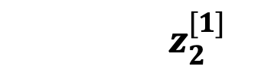
Vectorizing Input and All Variables
To help develop an efficient learning algorithm, let us vectorize (represent in vectors & matrices) the input and the variables involved
$$z_{1}^{[1]}$$
$$a_{1}^{[1]}$$
$$z^{[1]}=w^{{[1]}^{T}}x+b^{[1]}$$
$$x_{0}$$
$$=\left[\begin{aligned}w_{11}^{[1]}x_{1}+w_{21}^{[1]}x_{2}+w_{31}^{[1]}x_{3}+b_{1}^{[1]} \\ w_{12}^{[1]}{x_{1}+w}_{22}^{[1]}x_{2}+{ w}_{32}^{[1]}x_{3}+b_{2}^{[1]} \\ w_{13}^{[1]}x_{1}+{ w}_{23}^{[1]}x_{2}+{ w}_{33}^{[1]}x_{3}+b_{3}^{[1]} \\ w_{14}^{[1]}x_{1}+{ w}_{24}^{[1]}x_{2}+{ w}_{34}^{[1]}x_{3}+b_{4}^{[1]}\end{aligned}\right]$$
$$x_{1}$$
$$z_{2}^{[1]}$$
$$a_{2}^{[1]}$$
$$x_{2}$$
$$z_{1}^{[2]}$$
$$a_{1}^{[2]}$$
$$\hat{y}$$
$$z_{3}^{[1]}$$
$$a_{3}^{[1]}$$
$$x_{3}$$
Layer 2
$$z_{4}^{[1]}$$
$$a_{4}^{[1]}$$
Input Layer
(or Layer 0)
$a^{[1]}=σ(z^{[1]}$)
$${a_{2}^{[1]}=σ(z}_{2}^{[1]})$$
Layer 1

Slide 37
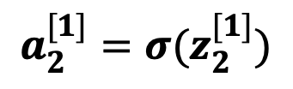
Vectorizing Input and All Variables
To help develop an efficient learning algorithm, let us vectorize (represent in vectors & matrices) the input and the variables involved
$$z_{1}^{[1]}$$
$$a_{1}^{[1]}$$
$$z^{[1]}=w^{{[1]}^{T}}x+b^{[1]}$$
$$x_{0}$$
$$=\left[\begin{aligned}w_{11}^{[1]}x_{1}+w_{21}^{[1]}x_{2}+w_{31}^{[1]}x_{3}+b_{1}^{[1]} \\ w_{12}^{[1]}{x_{1}+w}_{22}^{[1]}x_{2}+{ w}_{32}^{[1]}x_{3}+b_{2}^{[1]} \\ w_{13}^{[1]}x_{1}+{ w}_{23}^{[1]}x_{2}+{ w}_{33}^{[1]}x_{3}+b_{3}^{[1]} \\ w_{14}^{[1]}x_{1}+{ w}_{24}^{[1]}x_{2}+{ w}_{34}^{[1]}x_{3}+b_{4}^{[1]}\end{aligned}\right]$$
$$x_{1}$$
$$z_{2}^{[1]}$$
$$a_{2}^{[1]}$$
$$x_{2}$$
$$z_{1}^{[2]}$$
$$a_{1}^{[2]}$$
$$\hat{y}$$
$$z_{3}^{[1]}$$
$$a_{3}^{[1]}$$
$$x_{3}$$
Layer 2
$$z_{4}^{[1]}$$
$$a_{4}^{[1]}$$
Input Layer
(or Layer 0)
$a^{[1]}=σ(z^{[1]}$)
$${a_{2}^{[1]}=σ(z}_{2}^{[1]})$$
Layer 1

Slide 38
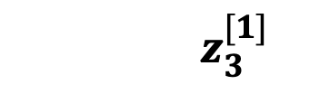
Vectorizing Input and All Variables
To help develop an efficient learning algorithm, let us vectorize (represent in vectors & matrices) the input and the variables involved
$$z_{1}^{[1]}$$
$$a_{1}^{[1]}$$
$$z^{[1]}=w^{{[1]}^{T}}x+b^{[1]}$$
$$x_{0}$$
$$=\left[\begin{aligned}w_{11}^{[1]}x_{1}+w_{21}^{[1]}x_{2}+w_{31}^{[1]}x_{3}+b_{1}^{[1]} \\ w_{12}^{[1]}{x_{1}+w}_{22}^{[1]}x_{2}+{ w}_{32}^{[1]}x_{3}+b_{2}^{[1]} \\ w_{13}^{[1]}x_{1}+{ w}_{23}^{[1]}x_{2}+{ w}_{33}^{[1]}x_{3}+b_{3}^{[1]} \\ w_{14}^{[1]}x_{1}+{ w}_{24}^{[1]}x_{2}+{ w}_{34}^{[1]}x_{3}+b_{4}^{[1]}\end{aligned}\right]$$
$$x_{1}$$
$$z_{2}^{[1]}$$
$$a_{2}^{[1]}$$
$$x_{2}$$
$$z_{1}^{[2]}$$
$$a_{1}^{[2]}$$
$$\hat{y}$$
$$z_{3}^{[1]}$$
$$a_{3}^{[1]}$$
$$x_{3}$$
Layer 2
$$z_{4}^{[1]}$$
$$a_{4}^{[1]}$$
Input Layer
(or Layer 0)
$a^{[1]}=σ(z^{[1]}$)
$${a_{3}^{[1]}=σ(z}_{3}^{[1]})$$
Layer 1

Slide 39
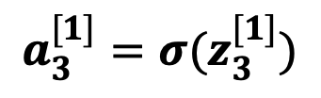
Vectorizing Input and All Variables
To help develop an efficient learning algorithm, let us vectorize (represent in vectors & matrices) the input and the variables involved
$$z_{1}^{[1]}$$
$$a_{1}^{[1]}$$
$$z^{[1]}=w^{{[1]}^{T}}x+b^{[1]}$$
$$x_{0}$$
$$=\left[\begin{aligned}w_{11}^{[1]}x_{1}+w_{21}^{[1]}x_{2}+w_{31}^{[1]}x_{3}+b_{1}^{[1]} \\ w_{12}^{[1]}{x_{1}+w}_{22}^{[1]}x_{2}+{ w}_{32}^{[1]}x_{3}+b_{2}^{[1]} \\ w_{13}^{[1]}x_{1}+{ w}_{23}^{[1]}x_{2}+{ w}_{33}^{[1]}x_{3}+b_{3}^{[1]} \\ w_{14}^{[1]}x_{1}+{ w}_{24}^{[1]}x_{2}+{ w}_{34}^{[1]}x_{3}+b_{4}^{[1]}\end{aligned}\right]$$
$$x_{1}$$
$$z_{2}^{[1]}$$
$$a_{2}^{[1]}$$
$$x_{2}$$
$$z_{1}^{[2]}$$
$$a_{1}^{[2]}$$
$$\hat{y}$$
$$z_{3}^{[1]}$$
$$a_{3}^{[1]}$$
$$x_{3}$$
Layer 2
$$z_{4}^{[1]}$$
$$a_{4}^{[1]}$$
Input Layer
(or Layer 0)
$a^{[1]}=σ(z^{[1]}$)
$${a_{3}^{[1]}=σ(z}_{3}^{[1]})$$
Layer 1

Slide 40
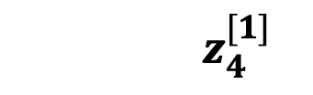
Vectorizing Input and All Variables
To help develop an efficient learning algorithm, let us vectorize (represent in vectors & matrices) the input and the variables involved
$$z_{1}^{[1]}$$
$$a_{1}^{[1]}$$
$$z^{[1]}=w^{{[1]}^{T}}x+b^{[1]}$$
$$x_{0}$$
$$=\left[\begin{aligned}w_{11}^{[1]}x_{1}+w_{21}^{[1]}x_{2}+w_{31}^{[1]}x_{3}+b_{1}^{[1]} \\ w_{12}^{[1]}{x_{1}+w}_{22}^{[1]}x_{2}+{ w}_{32}^{[1]}x_{3}+b_{2}^{[1]} \\ w_{13}^{[1]}x_{1}+{ w}_{23}^{[1]}x_{2}+{ w}_{33}^{[1]}x_{3}+b_{3}^{[1]} \\ w_{14}^{[1]}x_{1}+{ w}_{24}^{[1]}x_{2}+{ w}_{34}^{[1]}x_{3}+b_{4}^{[1]}\end{aligned}\right]$$
$$x_{1}$$
$$z_{2}^{[1]}$$
$$a_{2}^{[1]}$$
$$x_{2}$$
$$z_{1}^{[2]}$$
$$a_{1}^{[2]}$$
$$\hat{y}$$
$$z_{3}^{[1]}$$
$$a_{3}^{[1]}$$
$$x_{3}$$
Layer 2
$$z_{4}^{[1]}$$
$$a_{4}^{[1]}$$
Input Layer
(or Layer 0)
$a^{[1]}=σ(z^{[1]}$)
$${a_{4}^{[1]}=σ(z}_{4}^{[1]})$$
Layer 1

Slide 41
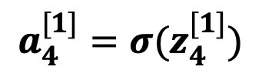
Vectorizing Input and All Variables
To help develop an efficient learning algorithm, let us vectorize (represent in vectors & matrices) the input and the variables involved
$$z_{1}^{[1]}$$
$$a_{1}^{[1]}$$
$$z^{[1]}=w^{{[1]}^{T}}x+b^{[1]}$$
$$x_{0}$$
$$=\left[\begin{aligned}w_{11}^{[1]}x_{1}+w_{21}^{[1]}x_{2}+w_{31}^{[1]}x_{3}+b_{1}^{[1]} \\ w_{12}^{[1]}{x_{1}+w}_{22}^{[1]}x_{2}+{ w}_{32}^{[1]}x_{3}+b_{2}^{[1]} \\ w_{13}^{[1]}x_{1}+{ w}_{23}^{[1]}x_{2}+{ w}_{33}^{[1]}x_{3}+b_{3}^{[1]} \\ w_{14}^{[1]}x_{1}+{ w}_{24}^{[1]}x_{2}+{ w}_{34}^{[1]}x_{3}+b_{4}^{[1]}\end{aligned}\right]$$
$$x_{1}$$
$$z_{2}^{[1]}$$
$$a_{2}^{[1]}$$
$$x_{2}$$
$$z_{1}^{[2]}$$
$$a_{1}^{[2]}$$
$$\hat{y}$$
$$z_{3}^{[1]}$$
$$a_{3}^{[1]}$$
$$x_{3}$$
Layer 2
$$z_{4}^{[1]}$$
$$a_{4}^{[1]}$$
Input Layer
(or Layer 0)
$a^{[1]}=σ(z^{[1]}$)
$${a_{4}^{[1]}=σ(z}_{4}^{[1]})$$
Layer 1

Slide 42






Vectorizing Input and All Variables
To help develop an efficient learning algorithm, let us vectorize (represent in vectors & matrices) the input and the variables involved
$$w^{[2]}=\left[\begin{aligned}w_{11}^{[2]} \\ { w}_{21}^{[2]} \\ { w}_{31}^{[2]} \\ { w}_{41}^{[2]}\end{aligned}\right]$$
$$z_{1}^{[1]}$$
$$a_{1}^{[1]}$$
$$w_{11}^{[2]}$$
$$x_{0}$$
$$z_{2}^{[1]}$$
$$a_{2}^{[1]}$$
$${ w}_{21}^{[2]}$$
$$x_{1}$$
$${ w}_{31}^{[2]}$$
$$z_{1}^{[2]}$$
$$a_{1}^{[2]}$$
$$\hat{y}$$
$$x_{2}$$
$$z_{3}^{[1]}$$
$$a_{3}^{[1]}$$
$${ w}_{41}^{[2]}$$
Dimension of${ w}^{[2]}$= (4, 1)
$$x_{3}$$
Layer 2
$$z_{4}^{[1]}$$
$$a_{4}^{[1]}$$
Input Layer
(or Layer 0)
Layer 1

Slide 43


Vectorizing Input and All Variables
To help develop an efficient learning algorithm, let us vectorize (represent in vectors & matrices) the input and the variables involved
$$z_{1}^{[1]}$$
$$a_{1}^{[1]}$$
$$w_{11}^{[2]}$$
$$w^{{[2]}^{T}}=\left[w_{11}^{[2]}{ w}_{21}^{[2]}{ w}_{31}^{[2]}{ w}_{41}^{[2]}\right]$$
$$x_{0}$$
$$z_{2}^{[1]}$$
$$a_{2}^{[1]}$$
$${ w}_{21}^{[2]}$$
$$x_{1}$$
Dimension of${ w}^{{[2]}^{T}}$= (1, 4)
$${ w}_{31}^{[2]}$$
$$z_{1}^{[2]}$$
$$a_{1}^{[2]}$$
$$\hat{y}$$
$$x_{2}$$
$$z_{3}^{[1]}$$
$$a_{3}^{[1]}$$
$${ w}_{41}^{[2]}$$
$$x_{3}$$
Layer 2
$$z_{4}^{[1]}$$
$$a_{4}^{[1]}$$
Input Layer
(or Layer 0)
Layer 1

Slide 44

Vectorizing Input and All Variables
To help develop an efficient learning algorithm, let us vectorize (represent in vectors & matrices) the input and the variables involved
$$z_{1}^{[1]}$$
$$a_{1}^{[1]}$$
$$x_{0}$$
$$b^{[2]}=\left[b_{1}^{[2]}\right]$$
$$x_{1}$$
$$z_{2}^{[1]}$$
$$a_{2}^{[1]}$$
$$x_{2}$$
$$z_{1}^{[2]}$$
$$a_{1}^{[2]}$$
$$\hat{y}$$
$$z_{3}^{[1]}$$
$$a_{3}^{[1]}$$
$$x_{3}$$
Layer 2
$$z_{4}^{[1]}$$
$$a_{4}^{[1]}$$
Input Layer
(or Layer 0)
Layer 1

Slide 45

Vectorizing Input and All Variables
To help develop an efficient learning algorithm, let us vectorize (represent in vectors & matrices) the input and the variables involved
$$z_{1}^{[1]}$$
$$a_{1}^{[1]}$$
$$x_{0}$$
$$z^{[2]}=\left[z_{1}^{[2]}\right]$$
$$x_{1}$$
$$z_{2}^{[1]}$$
$$a_{2}^{[1]}$$
$$x_{2}$$
$$z_{1}^{[2]}$$
$$a_{1}^{[2]}$$
$$\hat{y}$$
$$z_{3}^{[1]}$$
$$a_{3}^{[1]}$$
$$x_{3}$$
Layer 2
$$z_{4}^{[1]}$$
$$a_{4}^{[1]}$$
Input Layer
(or Layer 0)
Layer 1

Slide 46

Vectorizing Input and All Variables
To help develop an efficient learning algorithm, let us vectorize (represent in vectors & matrices) the input and the variables involved
$$z_{1}^{[1]}$$
$$a_{1}^{[1]}$$
$$x_{0}$$
$$a^{[2]}=\left[a_{1}^{[2]}\right]$$
$$x_{1}$$
$$z_{2}^{[1]}$$
$$a_{2}^{[1]}$$
$$x_{2}$$
$$z_{1}^{[2]}$$
$$a_{1}^{[2]}$$
$$\hat{y}$$
$$z_{3}^{[1]}$$
$$a_{3}^{[1]}$$
$$x_{3}$$
Layer 2
$$z_{4}^{[1]}$$
$$a_{4}^{[1]}$$
Input Layer
(or Layer 0)
Layer 1

Slide 47



Vectorizing Input and All Variables
To help develop an efficient learning algorithm, let us vectorize (represent in vectors & matrices) the input and the variables involved
$$z_{1}^{[1]}$$
$$a_{1}^{[1]}$$
$$z^{[2]}=w^{{[2]}^{T}}x+b^{[2]}$$
$$x_{0}$$
$$=w^{{[2]}^{T}}a^{[1]}+b^{[2]}$$
$$z_{2}^{[1]}$$
$$a_{2}^{[1]}$$
$$=\left[w_{11}^{[2]}{ w}_{21}^{[2]}{ w}_{31}^{[2]}{ w}_{41}^{[2]}\right]\left[\begin{aligned}a_{1}^{[1]} \\ a_{2}^{[1]} \\ a_{3}^{[1]} \\ a_{4}^{[1]}\end{aligned}\right]+\left[b_{1}^{[2]}\right]$$
$$x_{1}$$
$$x_{2}$$
$$z_{1}^{[2]}$$
$$a_{1}^{[2]}$$
$$\hat{y}$$
$$z_{3}^{[1]}$$
$$a_{3}^{[1]}$$
$$x_{3}$$
Layer 2
$$z_{4}^{[1]}$$
$$a_{4}^{[1]}$$
Input Layer
(or Layer 0)
Layer 1

Slide 48
Vectorizing Input and All Variables
To help develop an efficient learning algorithm, let us vectorize (represent in vectors & matrices) the input and the variables involved
$$z_{1}^{[1]}$$
$$a_{1}^{[1]}$$
$$z^{[2]}=w^{{[2]}^{T}}x+b^{[2]}$$
$$x_{0}$$
$$=w^{{[2]}^{T}}a^{[1]}+b^{[2]}$$
$$x_{1}$$
$$z_{2}^{[1]}$$
$$a_{2}^{[1]}$$
$$x_{2}$$
$$z_{1}^{[2]}$$
$$a_{1}^{[2]}$$
$$\hat{y}$$
$$=\left[w_{11}^{[2]}a_{1}^{[1]}+{ w}_{21}^{[2]}a_{2}^{[1]}+{ w}_{31}^{[2]}a_{3}^{[1]}+{ w}_{41}^{[2]}a_{4}^{[1]}\right]+\left[b_{1}^{[2]}\right]$$
$$z_{3}^{[1]}$$
$$a_{3}^{[1]}$$
$$x_{3}$$
Layer 2
$$z_{4}^{[1]}$$
$$a_{4}^{[1]}$$
Input Layer
(or Layer 0)
Layer 1

Slide 49
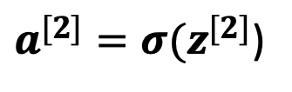
Vectorizing Input and All Variables
To help develop an efficient learning algorithm, let us vectorize (represent in vectors & matrices) the input and the variables involved
$$z_{1}^{[1]}$$
$$a_{1}^{[1]}$$
$$z^{[2]}=w^{{[2]}^{T}}x+b^{[2]}$$
$$x_{0}$$
$$=w^{{[2]}^{T}}a^{[1]}+b^{[2]}$$
$$x_{1}$$
$$z_{2}^{[1]}$$
$$a_{2}^{[1]}$$
$$x_{2}$$
$$z_{1}^{[2]}$$
$$a_{1}^{[2]}$$
$$\hat{y}$$
$$=\left[w_{11}^{[2]}a_{1}^{[1]}+{ w}_{21}^{[2]}a_{2}^{[1]}+{ w}_{31}^{[2]}a_{3}^{[1]}+{ w}_{41}^{[2]}a_{4}^{[1]}+b_{1}^{[2]}\right]$$
$$z_{3}^{[1]}$$
$$a_{3}^{[1]}$$
$$x_{3}$$
Layer 2
$$z_{4}^{[1]}$$
$$a_{4}^{[1]}$$
Input Layer
(or Layer 0)
$a^{[2]}=σ(z^{[2]}$)
Layer 1

Slide 50
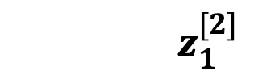
Vectorizing Input and All Variables
To help develop an efficient learning algorithm, let us vectorize (represent in vectors & matrices) the input and the variables involved
$$z_{1}^{[1]}$$
$$a_{1}^{[1]}$$
$$z^{[2]}=w^{{[2]}^{T}}x+b^{[2]}$$
$$x_{0}$$
$$=w^{{[2]}^{T}}a^{[1]}+b^{[2]}$$
$$x_{1}$$
$$z_{2}^{[1]}$$
$$a_{2}^{[1]}$$
$$x_{2}$$
$$z_{1}^{[2]}$$
$$a_{1}^{[2]}$$
$$\hat{y}$$
$$=\left[w_{11}^{[2]}a_{1}^{[1]}+{ w}_{21}^{[2]}a_{2}^{[1]}+{ w}_{31}^{[2]}a_{3}^{[1]}+{ w}_{41}^{[2]}a_{4}^{[1]}+b_{1}^{[2]}\right]$$
$$z_{3}^{[1]}$$
$$a_{3}^{[1]}$$
$$x_{3}$$
Layer 2
$$z_{4}^{[1]}$$
$$a_{4}^{[1]}$$
Input Layer
(or Layer 0)
$a^{[2]}=σ(z^{[2]}$)
$${a_{1}^{[2]}=σ(z}_{1}^{[2]})$$
Layer 1

Slide 51
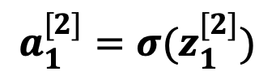
Vectorizing Input and All Variables
To help develop an efficient learning algorithm, let us vectorize (represent in vectors & matrices) the input and the variables involved
$$z_{1}^{[1]}$$
$$a_{1}^{[1]}$$
$$z^{[2]}=w^{{[2]}^{T}}x+b^{[2]}$$
$$x_{0}$$
$$=w^{{[2]}^{T}}a^{[1]}+b^{[2]}$$
$$x_{1}$$
$$z_{2}^{[1]}$$
$$a_{2}^{[1]}$$
$$x_{2}$$
$$z_{1}^{[2]}$$
$$a_{1}^{[2]}$$
$$\hat{y}$$
$$=\left[w_{11}^{[2]}a_{1}^{[1]}+{ w}_{21}^{[2]}a_{2}^{[1]}+{ w}_{31}^{[2]}a_{3}^{[1]}+{ w}_{41}^{[2]}a_{4}^{[1]}+b_{1}^{[2]}\right]$$
$$z_{3}^{[1]}$$
$$a_{3}^{[1]}$$
$$x_{3}$$
Layer 2
$$z_{4}^{[1]}$$
$$a_{4}^{[1]}$$
Input Layer
(or Layer 0)
$a^{[2]}=σ(z^{[2]}$)
$${a_{1}^{[2]}=σ(z}_{1}^{[2]})$$
Layer 1

Slide 52
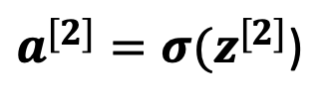



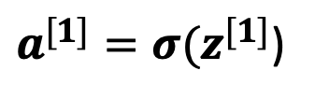
Vectorizing Input and All Variables
To help develop an efficient learning algorithm, let us vectorize (represent in vectors & matrices) the input and the variables involved
$$z_{1}^{[1]}$$
$$a_{1}^{[1]}$$
$$z^{[1]}=w^{{[1]}^{T}}x+b^{[1]}$$
$${x=a}^{[0]}$$
$a^{[1]}=σ(z^{[1]}$)
$$x_{1}$$
$$z_{2}^{[1]}$$
$$a_{2}^{[1]}$$
$$z_{1}^{[2]}$$
$$\hat{y}$$
$$z^{[2]}=w^{{[2]}^{T}}a^{[1]}+b^{[2]}$$
$$x_{2}$$
$$a_{1}^{[2]}$$
$$z_{3}^{[1]}$$
$$a_{3}^{[1]}$$
$a^{[2]}=σ(z^{[2]}$)
$$x_{3}$$
Layer 2
$$z_{4}^{[1]}$$
$$a_{4}^{[1]}$$
Input Layer
(or Layer 0)
Layer 1

Slide 53

Vectorizing Input and All Variables
To help develop an efficient learning algorithm, let us vectorize (represent in vectors & matrices) the input and the variables involved
$$z_{1}^{[1]}$$
$$a_{1}^{[1]}$$
$$z^{[1]}=w^{{[1]}^{T}}a^{[0]}+b^{[1]}$$
$${x=a}^{[0]}$$
$a^{[1]}=σ(z^{[1]}$)
$$x_{1}$$
$$z_{2}^{[1]}$$
$$a_{2}^{[1]}$$
$$z_{1}^{[2]}$$
$$\hat{y}$$
$$z^{[2]}=w^{{[2]}^{T}}a^{[1]}+b^{[2]}$$
$$x_{2}$$
$$a_{1}^{[2]}$$
$$z_{3}^{[1]}$$
$$a_{3}^{[1]}$$
$a^{[2]}=σ(z^{[2]}$)
$$x_{3}$$
Layer 2
But, this assumes only 1 training example!
$$z_{4}^{[1]}$$
$$a_{4}^{[1]}$$
Input Layer
(or Layer 0)
Layer 1

Slide 54
Vectorizing Input and All Variables
To help develop an efficient learning algorithm, let us vectorize (represent in vectors & matrices) the input and the variables involved
$$z_{1}^{[1]}$$
$$a_{1}^{[1]}$$
$$z^{[1]}=w^{{[1]}^{T}}a^{[0]}+b^{[1]}$$
$${x=a}^{[0]}$$
$a^{[1]}=σ(z^{[1]}$)
$$x_{1}$$
$$z_{2}^{[1]}$$
$$a_{2}^{[1]}$$
$$z_{1}^{[2]}$$
$$\hat{y}$$
$$z^{[2]}=w^{{[2]}^{T}}a^{[1]}+b^{[2]}$$
$$x_{2}$$
$$a_{1}^{[2]}$$
$$z_{3}^{[1]}$$
$$a_{3}^{[1]}$$
$a^{[2]}=σ(z^{[2]}$)
$$x_{3}$$
Layer 2
How can we account for all the training examples?
$$z_{4}^{[1]}$$
$$a_{4}^{[1]}$$
Input Layer
(or Layer 0)
Layer 1

Slide 55
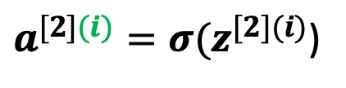



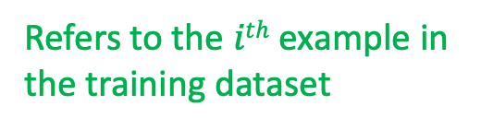
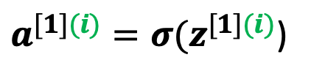

Vectorizing Input and All Variables
To help develop an efficient learning algorithm, let us vectorize (represent in vectors & matrices) the input and the variables involved
$$z_{1}^{[1]}$$
Assuming $n$ examples
$$a_{1}^{[1]}$$
$$for i=1 to n:$$
$${x=a}^{[0]}$$
$$z^{[1](i)}=w^{{\left[1\right]}^{T}(i)}a^{[0](i)}+b^{[1]}$$
$$x_{1}$$
$$z_{2}^{[1]}$$
$$a_{2}^{[1]}$$
$a^{[1](i)}=σ(z^{[1](i)}$)
$$x_{2}$$
$$z_{1}^{[2]}$$
$$a_{1}^{[2]}$$
$$\hat{y}$$
$$z_{3}^{[1]}$$
$$a_{3}^{[1]}$$
$$z^{[2](i)}=w^{{[2]}^{T(i)}}a^{[1](i)}+b^{[2]}$$
$$x_{3}$$
Layer 2
$a^{[2](i)}=σ(z^{[2](i)}$)
$$z_{4}^{[1]}$$
$$a_{4}^{[1]}$$
Input Layer
(or Layer 0)
Refers to the $ith$ example in
the training dataset
Layer 1

Slide 56
Vectorizing Input and All Variables
To help develop an efficient learning algorithm, let us vectorize (represent in vectors & matrices) the input and the variables involved
But, loops in general slow down programs; hence, it is better to further vectorize the implementation in order to
avoid any loop, whenever possible
$$z_{1}^{[1]}$$
Assuming $n$ examples
$$a_{1}^{[1]}$$
$$for i=1 to n:$$
$${x=a}^{[0]}$$
$$z^{[1](i)}=w^{{\left[1\right]}^{T}(i)}a^{[0](i)}+b^{[1]}$$
$$x_{1}$$
$$z_{2}^{[1]}$$
$$a_{2}^{[1]}$$
$a^{[1](i)}=σ(z^{[1](i)}$)
$$x_{2}$$
$$z_{1}^{[2]}$$
$$a_{1}^{[2]}$$
$$\hat{y}$$
$$z_{3}^{[1]}$$
$$a_{3}^{[1]}$$
$$z^{[2](i)}=w^{{[2]}^{T(i)}}a^{[1](i)}+b^{[2]}$$
$$x_{3}$$
Layer 2
$a^{[2](i)}=σ(z^{[2](i)}$)
$$z_{4}^{[1]}$$
$$a_{4}^{[1]}$$
Input Layer
(or Layer 0)
Refers to the $ith$ example in
the training dataset
Layer 1

Slide 57

Vectorizing Input and All Variables
To help develop an efficient learning algorithm, let us vectorize (represent in vectors & matrices) the input and the variables involved
To this end, we can simply stack all $x$ vectors (or $a^{[0]}$ vectors), $z$ vectors, and $a$ vectors in different matrices of every layer!
$$z_{1}^{[1]}$$
Assuming $n$ examples
$$a_{1}^{[1]}$$
$$for i=1 to n:$$
$${x=a}^{[0]}$$
$$z^{[1](i)}=w^{{\left[1\right]}^{T}(i)}a^{[0](i)}+b^{[1]}$$
$$x_{1}$$
$$z_{2}^{[1]}$$
$$a_{2}^{[1]}$$
$a^{[1](i)}=σ(z^{[1](i)}$)
$$x_{2}$$
$$z_{1}^{[2]}$$
$$a_{1}^{[2]}$$
$$\hat{y}$$
$$z_{3}^{[1]}$$
$$a_{3}^{[1]}$$
$$z^{[2](i)}=w^{{[2]}^{T(i)}}a^{[1](i)}+b^{[2]}$$
$$x_{3}$$
Layer 2
$a^{[2](i)}=σ(z^{[2](i)}$)
$$z_{4}^{[1]}$$
$$a_{4}^{[1]}$$
Input Layer
(or Layer 0)
Refers to the $ith$ example in
the training dataset
Layer 1

Slide 58
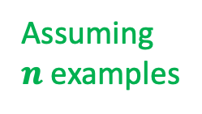
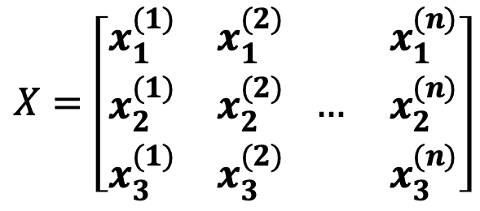
Vectorizing Input and All Variables
To help develop an efficient learning algorithm, let us vectorize (represent in vectors & matrices) the input and the variables involved
$$z_{1}^{[1]}$$
$$a_{1}^{[1]}$$
$$X=\left[\begin{matrix}x_{1}^{(1)} & x_{1}^{(2)} \\ \begin{aligned}x_{2}^{(1)} \\ x_{3}^{(1)}\end{aligned} & \begin{aligned}x_{2}^{(2)} \\ x_{3}^{(2)}\end{aligned}\end{matrix} \begin{matrix} & x_{1}^{(n)} \\ \begin{aligned}… \\ \end{aligned} & \begin{aligned}x_{2}^{(n)} \\ x_{3}^{(n)}\end{aligned}\end{matrix}\right]$$
Assuming
$n$ examples
$${x=a}^{[0]}$$
$$x_{1}$$
$$z_{2}^{[1]}$$
$$a_{2}^{[1]}$$
$$x_{2}$$
$$z_{1}^{[2]}$$
$$a_{1}^{[2]}$$
$$\hat{y}$$
$$z_{3}^{[1]}$$
$$a_{3}^{[1]}$$
$$x_{3}$$
Layer 2
This vector represents the first
example in the training dataset
$$z_{4}^{[1]}$$
$$a_{4}^{[1]}$$
Input Layer
(or Layer 0)
Layer 1

Slide 59
Vectorizing Input and All Variables
To help develop an efficient learning algorithm, let us vectorize (represent in vectors & matrices) the input and the variables involved
$$z_{1}^{[1]}$$
$$a_{1}^{[1]}$$
$$X=\left[\begin{matrix}x_{1}^{(1)} & x_{1}^{(2)} \\ \begin{aligned}x_{2}^{(1)} \\ x_{3}^{(1)}\end{aligned} & \begin{aligned}x_{2}^{(2)} \\ x_{3}^{(2)}\end{aligned}\end{matrix} \begin{matrix} & x_{1}^{(n)} \\ \begin{aligned}… \\ \end{aligned} & \begin{aligned}x_{2}^{(n)} \\ x_{3}^{(n)}\end{aligned}\end{matrix}\right]$$
Assuming
$n$ examples
$${x=a}^{[0]}$$
$$x_{1}$$
$$z_{2}^{[1]}$$
$$a_{2}^{[1]}$$
$$x_{2}$$
$$z_{1}^{[2]}$$
$$a_{1}^{[2]}$$
$$\hat{y}$$
$$z_{3}^{[1]}$$
$$a_{3}^{[1]}$$
$$x_{3}$$
Layer 2
This vector represents the second
example in the training dataset
$$z_{4}^{[1]}$$
$$a_{4}^{[1]}$$
Input Layer
(or Layer 0)
Layer 1

Slide 60

Vectorizing Input and All Variables
To help develop an efficient learning algorithm, let us vectorize (represent in vectors & matrices) the input and the variables involved
$$z_{1}^{[1]}$$
$$a_{1}^{[1]}$$
$$X=\left[\begin{matrix}x_{1}^{(1)} & x_{1}^{(2)} \\ \begin{aligned}x_{2}^{(1)} \\ x_{3}^{(1)}\end{aligned} & \begin{aligned}x_{2}^{(2)} \\ x_{3}^{(2)}\end{aligned}\end{matrix} \begin{matrix} & x_{1}^{(n)} \\ \begin{aligned}… \\ \end{aligned} & \begin{aligned}x_{2}^{(n)} \\ x_{3}^{(n)}\end{aligned}\end{matrix}\right]$$
Assuming
$n$ examples
$${x=a}^{[0]}$$
$$x_{1}$$
$$z_{2}^{[1]}$$
$$a_{2}^{[1]}$$
$$x_{2}$$
$$z_{1}^{[2]}$$
$$a_{1}^{[2]}$$
$$\hat{y}$$
$$z_{3}^{[1]}$$
$$a_{3}^{[1]}$$
$$x_{3}$$
Layer 2
This vector represents the $nth$
example in the training dataset
$$z_{4}^{[1]}$$
$$a_{4}^{[1]}$$
Input Layer
(or Layer 0)
Layer 1

Slide 61


Vectorizing Input and All Variables
To help develop an efficient learning algorithm, let us vectorize (represent in vectors & matrices) the input and the variables involved
$$z_{1}^{[1]}$$
$$a_{1}^{[1]}$$
$$X=\left[\begin{matrix}a_{1}^{[0](1)} & a_{1}^{[0](2)} \\ \begin{aligned}a_{2}^{[0](1)} \\ a_{3}^{[0](1)}\end{aligned} & \begin{aligned}a_{2}^{[0](2)} \\ a_{3}^{[0](2)}\end{aligned}\end{matrix} \begin{matrix} & a_{1}^{[0](n)} \\ \begin{aligned}… \\ \end{aligned} & \begin{aligned}a_{2}^{[0](n)} \\ a_{3}^{[0](n)}\end{aligned}\end{matrix}\right]$$
$${x=a}^{[0]}$$
$$x_{1}$$
$$z_{2}^{[1]}$$
$$a_{2}^{[1]}$$
$$x_{2}$$
$$z_{1}^{[2]}$$
$$a_{1}^{[2]}$$
$$\hat{y}$$
$$z_{3}^{[1]}$$
$$a_{3}^{[1]}$$
$$x_{3}$$
Layer 2
If we denote $x$ as $a^{[0]}$
$$z_{4}^{[1]}$$
$$a_{4}^{[1]}$$
Input Layer
(or Layer 0)
Layer 1

Slide 62
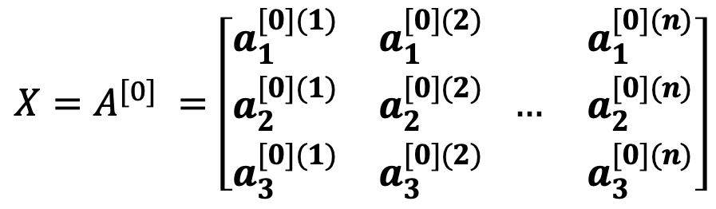
Vectorizing Input and All Variables
To help develop an efficient learning algorithm, let us vectorize (represent in vectors & matrices) the input and the variables involved
$$z_{1}^{[1]}$$
$$a_{1}^{[1]}$$
$$X=A^{[0]} =\left[\begin{matrix}a_{1}^{[0](1)} & a_{1}^{[0](2)} \\ \begin{aligned}a_{2}^{[0](1)} \\ a_{3}^{[0](1)}\end{aligned} & \begin{aligned}a_{2}^{[0](2)} \\ a_{3}^{[0](2)}\end{aligned}\end{matrix} \begin{matrix} & a_{1}^{[0](n)} \\ \begin{aligned}… \\ \end{aligned} & \begin{aligned}a_{2}^{[0](n)} \\ a_{3}^{[0](n)}\end{aligned}\end{matrix}\right]$$
$${x=a}^{[0]}$$
$$x_{1}$$
$$z_{2}^{[1]}$$
$$a_{2}^{[1]}$$
$$x_{2}$$
$$z_{1}^{[2]}$$
$$a_{1}^{[2]}$$
$$\hat{y}$$
$$z_{3}^{[1]}$$
$$a_{3}^{[1]}$$
$$x_{3}$$
Layer 2
If we denote $x$ as $a^{[0]}$
$$z_{4}^{[1]}$$
$$a_{4}^{[1]}$$
Input Layer
(or Layer 0)
Layer 1

Slide 63

Vectorizing Input and All Variables
To help develop an efficient learning algorithm, let us vectorize (represent in vectors & matrices) the input and the variables involved
$$z_{1}^{[1]}$$
$$a_{1}^{[1]}$$
$$Z^{[1]}=\left[\begin{aligned}z_{1}^{[1](1)} \\ z_{2}^{[1](1)} \\ z_{3}^{[1](1)} \\ z_{4}^{[1](1)}\end{aligned} \begin{aligned}z_{1}^{[1](2)} \\ z_{2}^{[1](2)} \\ z_{3}^{[1](2)} \\ z_{4}^{[1](2)}\end{aligned} \begin{aligned} \\ \\ … \\ \end{aligned} \begin{aligned}z_{1}^{[1](n)} \\ z_{2}^{[1](n)} \\ z_{3}^{[1](n)} \\ z_{4}^{[1](n)}\end{aligned}\right]$$
$${x=a}^{[0]}$$
$$x_{1}$$
$$z_{2}^{[1]}$$
$$a_{2}^{[1]}$$
$$x_{2}$$
$$z_{1}^{[2]}$$
$$a_{1}^{[2]}$$
$$\hat{y}$$
$$z_{3}^{[1]}$$
$$a_{3}^{[1]}$$
$$x_{3}$$
Layer 2
$$z_{4}^{[1]}$$
$$a_{4}^{[1]}$$
Input Layer
(or Layer 0)
Layer 1

Slide 64

Vectorizing Input and All Variables
To help develop an efficient learning algorithm, let us vectorize (represent in vectors & matrices) the input and the variables involved
$$z_{1}^{[1]}$$
$$a_{1}^{[1]}$$
$$A^{[1]}=\left[\begin{aligned}a_{1}^{[1](1)} \\ a_{2}^{[1](1)} \\ a_{3}^{[1](1)} \\ a_{4}^{[1](1)}\end{aligned} \begin{aligned}a_{1}^{[1](2)} \\ a_{2}^{[1](2)} \\ a_{3}^{[1](2)} \\ a_{4}^{[1](2)}\end{aligned} \begin{aligned} \\ \\ … \\ \end{aligned} \begin{aligned}a_{1}^{[1](n)} \\ a_{2}^{[1](n)} \\ a_{3}^{[1](n)} \\ a_{4}^{[1](n)}\end{aligned}\right]$$
$${x=a}^{[0]}$$
$$x_{1}$$
$$z_{2}^{[1]}$$
$$a_{2}^{[1]}$$
$$x_{2}$$
$$z_{1}^{[2]}$$
$$a_{1}^{[2]}$$
$$\hat{y}$$
$$z_{3}^{[1]}$$
$$a_{3}^{[1]}$$
$$x_{3}$$
Layer 2
$$z_{4}^{[1]}$$
$$a_{4}^{[1]}$$
Input Layer
(or Layer 0)
Layer 1

Slide 65
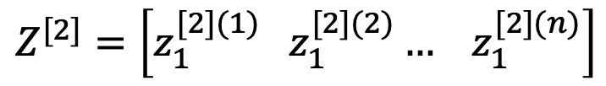
Vectorizing Input and All Variables
To help develop an efficient learning algorithm, let us vectorize (represent in vectors & matrices) the input and the variables involved
$$z_{1}^{[1]}$$
$$a_{1}^{[1]}$$
$${x=a}^{[0]}$$
$$Z^{[2]}=\left[z_{1}^{[2](1)} z_{1}^{[2](2)}… { z}_{1}^{[2](n)}\right]$$
$$x_{1}$$
$$z_{2}^{[1]}$$
$$a_{2}^{[1]}$$
$$x_{2}$$
$$z_{1}^{[2]}$$
$$a_{1}^{[2]}$$
$$\hat{y}$$
$$z_{3}^{[1]}$$
$$a_{3}^{[1]}$$
$$x_{3}$$
Layer 2
$$z_{4}^{[1]}$$
$$a_{4}^{[1]}$$
Input Layer
(or Layer 0)
Layer 1

Slide 66

Vectorizing Input and All Variables
To help develop an efficient learning algorithm, let us vectorize (represent in vectors & matrices) the input and the variables involved
$$z_{1}^{[1]}$$
$$a_{1}^{[1]}$$
$${x=a}^{[0]}$$
$$A^{[2]}=\left[a_{1}^{[2](1)} a_{1}^{[2](2)}… { a}_{1}^{[2](n)}\right]$$
$$x_{1}$$
$$z_{2}^{[1]}$$
$$a_{2}^{[1]}$$
$$x_{2}$$
$$z_{1}^{[2]}$$
$$a_{1}^{[2]}$$
$$\hat{y}$$
$$z_{3}^{[1]}$$
$$a_{3}^{[1]}$$
$$x_{3}$$
Layer 2
$$z_{4}^{[1]}$$
$$a_{4}^{[1]}$$
Input Layer
(or Layer 0)
Layer 1

Slide 67
Vectorizing Input and All Variables
To help develop an efficient learning algorithm, let us vectorize (represent in vectors & matrices) the input and the variables involved
$$z_{1}^{[1]}$$
$$a_{1}^{[1]}$$
$$for i=1 to n:$$
$${x=a}^{[0]}$$
$$z^{[1](i)}=w^{{\left[1\right]}^{T}(i)}a^{[0](i)}+b^{[1]}$$
$$x_{1}$$
$$z_{2}^{[1]}$$
$$a_{2}^{[1]}$$
$a^{[1](i)}=σ(z^{[1](i)}$)
$$x_{2}$$
$$z_{1}^{[2]}$$
$$a_{1}^{[2]}$$
$$\hat{y}$$
$$z_{3}^{[1]}$$
$$a_{3}^{[1]}$$
$$z^{[2](i)}=w^{{[2]}^{T(i)}}a^{[1](i)}+b^{[2]}$$
$$x_{3}$$
Layer 2
$a^{[2](i)}=σ(z^{[2](i)}$)
$$z_{4}^{[1]}$$
$$a_{4}^{[1]}$$
Input Layer
(or Layer 0)
Before Vectorization
Layer 1

Slide 68





Vectorizing Input and All Variables
To help develop an efficient learning algorithm, let us vectorize (represent in vectors & matrices) the input and the variables involved
$$z_{1}^{[1]}$$
$$a_{1}^{[1]}$$
No Explicit Loop!
$$for i=1 to n:$$
$${x=a}^{[0]}$$
$$Z^{[1]}=w^{{\left[1\right]}^{T}}A^{[0]}+b^{[1]}$$
$$x_{1}$$
$$z_{2}^{[1]}$$
$$a_{2}^{[1]}$$
$A^{[1]}=σ(Z^{[1]}$)
$$x_{2}$$
$$z_{1}^{[2]}$$
$$a_{1}^{[2]}$$
$$\hat{y}$$
$$z_{3}^{[1]}$$
$$a_{3}^{[1]}$$
$$Z^{[2]}=w^{{[2]}^{T}}A^{[1]}+b^{[2]}$$
$$x_{3}$$
Layer 2
$A^{[2]}=σ(Z^{[2]}$)
$$z_{4}^{[1]}$$
$$a_{4}^{[1]}$$
Input Layer
(or Layer 0)
After Vectorization
Layer 1

Slide 69
Next Monday’s Lecture…
Deep Learning
Overview
Vectorization
Computation Graph
Gradient Descent

